Slide 1

Application Security
Microsof Security Development Lifecycle (SDL/S-­‐SDLC)
JavaScript Security
Vulnerabilities
XSS (Cross-­‐Site Scripting)
CSR (Cross-­‐Site Request Forgery)
OWASP Mobile Top 10

Slide 2
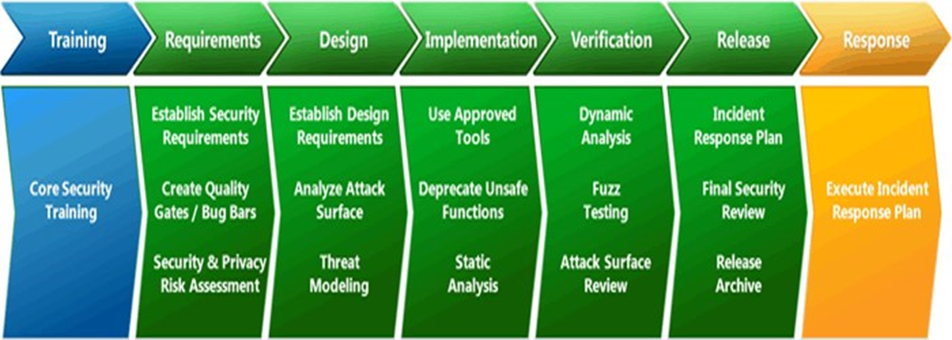

Slide 3
Microsoft: Security Development Lifecycle
Phase One: Training
Practice #1: Core Security Training
Stay informed about security basics and recent trends in security and privacy
Frequency: at least one security training class each year
Phase Two: Requirements
• Practice #2: Establish Security and Privacy Requirements
Identify key milestones and deliverables
Assign security experts
Define minimum security and privacy criteria for an application
Deploying a security vulnerability/work item tracking system

Slide 4
Microsoft: Security Development Lifecycle
Practice #3: Create Quality Gates/Bug Bars
Define minimum acceptable levels of security and privacy quality
Set a meaningful bug bar(i.e., severity thresholds of security vulnerabilities)
Practice #4: Perform Security and Privacy Risk Assessments
Examine software design based on costs and regulatory requirements
Identify need for threat modeling and security design reviews

Slide 5
Microsoft: Security Development Lifecycle
Phase Three: Design
• Practice #5: Establish Design Requirements
Address security and privacy concerns early to minimize the risk of schedule disruptions and reduce a project's expense.
Validate all design specifications against a functional specification
Practice #6: Perform Attack Surface Analysis/Reduction
Thoroughly analyze overall Attack surface
Disable or restrict access to system services
Apply the principle of least privilege
Employing layered defenses

Slide 6
Microsoft: Security Development Lifecycle
Practice #7: Use Threat Modeling
Identify need for threat modeling and security design reviews
Apply a structured approach to threat scenarios to identify security vulnerabilities, determine risks from those threats, and establish appropriate mitigations
Phase Four: Implementation
• Practice #8: Use Approved Tools
Publish a list of approved tools and associated security checks
Keep the list regularly updated
Deploying security vulnerability/work item tracking system

Slide 7
Microsoft: Security Development Lifecycle
Practice #9: Create Quality Gates/Bug Bars
Define minimum acceptable levels of security and privacy quality
Set a meaningful bug bar (i.e., severity thresholds of security vulnerabilities)
Practice #10: Perform Security and Privacy Risk Assessments
Examine software design based on costs and regulatory requirements
IdenIfy need for threat modeling and security design reviews

Slide 8
Microsoft: Security Development Lifecycle
Phase Five: Verification
• Practice #11: Perform Dynamic Analysis
Perform run-time verification of the software
Check functionality using tools that monitor application behavior for memory corruption, user privilege issues, and other critical security problems.
Practice #12: Perform Fuzz Testing
Induce program failure by deliberately introducing malformed or random data to the application
Practice #13: Conduct Attack Surface Review
Review Attack surface upon code completion
Ensure that any new Attack vectors created as a result of the changes have been reviewed and mitigated including threat models

Slide 9
Microsoft: Security Development Lifecycle
Phase Six: Release
• Practice #14: Create an Incident Response Plan
Prepare an Incident Response Plan to address new threats that can emerge over time
identify appropriate security emergency contacts
establish security servicing plans for code inherited from other groups within the organization and for licensed third-­‐party code
Practice #15: Conduct Final Security Review
Review all security activities that were performed to ensure software release readiness.
Examine threat models, tools outputs and performance against the quality gates and bug bars defined during the Requirements Phase
Practice #16: Certify Release and Archive
Certify software prior to a release to ensure security and privacy requirements were met
Archive all specifications, source code, binaries, private symbols, threat models, documentation, emergency response plans, and license and servicing terms for any third-­‐party software.

Slide 10
Microsoft: Security Development Lifecycle
Phase Seven: Response
• Practice #17: Execute Incident Response Plan
Implement the Incident Response Plan instituted in the Release phase
Deliver security updates and authoritative security guidance

Slide 11
JavaScript Security Model
The JavaScript Security Model
Open scripting language
JavaScript security model attempts to protect the user from websites that may be malicious
Not designed to protect the website owner
Not designed to protect data sent from the browser to the server
There are limits on what the page author can control via JavaScript executing within the browser

Slide 12
JavaScript Security Model
File I/O
Scripts cannot read or write to the client file-­‐system
Scripts cannot directly create or delete files on the server file-­‐system
Scripts can store cookies on the client computer
Note: Web Storage – W3C Working Draft www.w3.org/TR/webstorage/
Scripts cannot access cookies from other sites
File Upload
Scripts cannot be used to set the value attribute of a file input tag and cannot use file input tags without permission
Access to the location object
Cannot determine what other pages a user has open
User interaction with applications
Cannot determine user interaction with other aspects of browser application
• | No File() object
• | No file access functions

Slide 13
JavaScript Security Model
Window close() method
JavaScript does support a close() method for the window object however, browsers should restrict this method so that a script can only close a window, that was opened by a script from the same web server. JavaScript should not be allowed to close a window that a user opened without confirmation from the user.
Window Characteristics
A script
cannot open a window that is smaller than 100px on a side
cannot move a window of the screen
cannot create a window bigger than the screen
cannot create a window without a title bar
Events
A script cannot register event listeners or capture events for documents loaded from different sources

Slide 14
JavaScript Security Model
Networking
Can load URLs
Can send HTML form data to webservers/email addresses
Cannot establish a direct connection to any other hosts on a network
Note: See WebSocket Reference at http://tools.ie=.org/pdf/rfc64titi.pdf
However
Many web browsers make use of JavaScript as a ‘script engine’ for other software components such as ActiveX components and other plugins. These components may have file-­‐system and networking capabilities.

Slide 15
JavaScript Security Model
Data Privacy
Information about the browser that is being used is sent as part of the HTTP request
The IP address of your internet connection is available
Your browsing history should remain private
JavaScript should not be able to examine the contents of other pages you are viewing - Consider the implications if you were also accessing a company’s internal intranet application
The Same-Origin Policy - This policy dates all the way back to Netscape Navigator 2.0
a script can read only the properties of windows and documents that have the same origin (i.e., that were loaded from the same host, through the same port, and by the same protocol) as the script itself.
JavaScript The DefiniIve Guide

Slide 16
JavaScript Security Model
Can be problematic for large web‐sites using more than one server – Restricts capabilities to create mash--‐up type applications that access cross site data
JavaScript 1.1 introduced the domain property of the document object. This property can be set to a valid domain suffix of the domain from which the document was loaded
If domain was www.mysite.com by default then it could be reset to mysite.com
Example: A page loaded from www.mysite.com may legitimately need information from a page loaded from developer.mysite.com
Does not apply to the scripts themselves
All scripts run with the same authority
<html>
<head>
<script src=“http://www.hackrus.com/felixkrull.js”></script>
<script src=“http://www.domdadomdom.com/thefix.js”></script>
<title>Erewhon</title>
</head>
<body></body>
</html>
External scripts can be loaded from different domains

Slide 17
Vulnerabilities
JavaScript’s openness •
Uses global objects –
Functions can have global scope
In a browser the window object is global
HTML originally designed for delivery of static web‐pages – not to manage modular software applications
Method/Property | Exception
window.focus(),window.blur(), window.close() | Not subject to same origin policy in most browsers.
window.location | Sepng this property is not subject to same origin policy in most browsers.
window.open() | Not subject to same origin policy in Internet Explorer.
history.back(), history.go(), history.forward(), | Not subject to same origin policy in Mozilla and Netscape browsers.

Slide 18
Vulnerabilities
vulnerabilities
Implications
Different scripts can interact with the same objects
Overwrite variables
Redefine functions
Override native methods
Extend native objects
Initiate HTTP requests (GET / POST)
Obtain cookie information
Attacks
XSS (Cross--‐Site Scripting)
CSRF (Cross--‐Site Request Forgery)

Slide 19
XSS
https://www.owasp.org/index.php/Cross--‐site_ScripIng_(XSS)

Slide 20
XSS
Script Injection
Exploit vulnerability that allows scripts from a malicious source to be executed on client browser
Multiple sources used to construct HTML response page •
Prevention measures
Validate, filter, sanitise all input
Process output response stream data through encoding
Many modern browsers will attempt to detect an XSS attack and notify the user
Types
Reflected
Stored
DOM--‐based

Slide 21
XSS
Reflected XSS Attack (Active)
Malicious input is immediately sent back (reflected) from the server to the browser
Error Messages
Search Results
Usually delivered to an unsuspecting user via an email or a link on some other server
User clicks the link sending attack script to the server with the script reflected back
Browser then executes script
Stored XSS Attack (Passive)
Malicious input is stored on the server. At a later stage the server responds with web--‐ pages containing the stored content
Database
Message Forum
When the user requests the page the server dynamically generates the response containing the malicious script
Then the script executes

Slide 22
XSS
DOM--‐based XSS Attack (Type--‐0 Attack)
Takes advantage of vulnerabilities in a page’s DOM environment based on original page script
Makes the code run in an unintended manner
Example: The document.location.href property is used to generate some content in a page via a document.write command. In this case the script could be written into a link.
See https://www.owasp.org/index.php/DOM_Based_XSS
When encoding data for the output stream encode as late as possible
Minimise chance of multiple encoding
Take care not to corrupt the output stream
Use encoding libraries
JSON objects may also be used with DOM--‐based XSS attacks
JSON objects should be validated (see www.json.org)
Use Http Only cookies
Available in some browsers
Prevents client side script from accessing cookies

Slide 23
XSS
See
https://www.owasp.org/index.php/XSS_(Cross_Site_Scripting)_Prevention_Cheat_Sheet
See also
http://ha.ckers.org/xss.html

Slide 24
XSS
Let’s add the following to the search input box
http://testasp.vulnweb.com/
<br><br>Please login with the form below before proceeding:
<form action="mybadsite.aspx"><table><tr><td>Login:</td><td>
<input type=text length=20 name=login></td></tr><tr><td>Password:</td><td>
<input type=text length=20 name=password></td></tr></table><input type=submit value=LOGIN></form>

Slide 25
XSS

Slide 26
CSRF

Slide 27
CSRF
Exploits vulnerability in which websites assume that all user interactions are purposeful. –
CSRF attempts to perform actions that were not intended
Uses XSS and a confused deputy
Confused deputy is the browser
Example:
Adding an <img> tag with the src specified as an action based URL
Session Hijacking

Slide 28
CSRF
Mitigation of CSRF attacks
Implement strong XSS mitigations
Use Tokens to verify expected user actions
Hidden form value fields
E.g., RoR & ASP.Net MVC provide framework support
Use POST for any actions that alter data on server side
Is the idempotent web paradigm for Http GET compromised?
Check Http Referrer

Slide 29
OWASP Mobile Top 10 Risks 2014

Slide 30
OWASP Mobile Top 10 Risks 2014
Weak Server Side Controls

Slide 31
OWASP Mobile Top 10 Risks 2014
Insecure Data Storage
iOS Specific Best Practices:
Never store credentials on the phone file system. Force the user to authenticate using a standard web or API login scheme (over HTTPS) to the application upon each opening and ensure session timeouts are set at the bare minimum to meet the user experience requirements.
Where storage or caching of information is necessary consider using a standard iOS encryption library such as CommonCrypto. However, for particularly sensitive apps, consider using whitebox cryptography solutions that avoid the leakage of binary signatures found within common encryption libraries.
If the data is small, using the provided apple keychain API is recommended but, once a phone is jailbroken or exploited the keychain an be easily read. This is in addition to the threat of a bruteforce on the devices PIN, which as stated above is trivial in some cases.
For databases consider using SQLcipher for Sqlite data encryption
For items stored in the keychain leverage the most secure API designation, kSecAarAccessibleWhenUnlocked (now the default in iOS 5) and for enterprise managed mobile devices ensure a strong PIN is forced, alphanumeric, larger than 4 characters.
For larger or more general types of consumer--‐grade data, Apple’s File Protection mechanism can safely be used (see NSData Class Reference for protection options).
Avoid using NSUserDefaults to store sensitive pieces of information as it stores data in plist files.
Be aware that all data/enIties using NSManagedObects will be stored in an unencrypted database file.
Avoid exclusively relying upon hardcoded encryption or decryption keys when storing sensitive information assets.
Consider providing an additional layer of encryption beyond any default encryption mechanisms provided by the operating system

Slide 32
OWASP Mobile Top 10 Risks 2014
Insecure Data Storage
Android Specific Best Practices:
For local storage the enterprise android device administration API can be used to force encryption to local file--‐stores using “setStorageEncrypIon”
For SD Card Storage some security can be achieved via the ‘javax.crypto’ library. You have a few options, but an easy one is simply to encrypt any plain text data with a master password and AES 128.
Ensure any shared preferences properties are NOT MODE_WORLD_READABLE unless explicitly required for information sharing between apps.
Avoid exclusively relying upon hardcoded encryption or decryption keys when storing sensitive information assets.
Consider providing an additional layer of encryption beyond any default encryption mechanisms provided by the operating system.

Slide 33
OWASP Mobile Top 10 Risks 2014: Insufficient Transport Layer Protection
General Best Practices: –
Assume that the network layer is not secure and is susceptible to eavesdropping.
Apply SSL/TLS to transport channels that the mobile app will use to transmit sensitive information, session tokens, or other sensitive data to a backend API or web service.
Account for outside entities like third--‐party analytics companies, social networks, etc. by using their SSL versions when an application runs a routine via the browser/webkit. Avoid mixed SSL sessions as they may expose the user’s session ID.
Use strong, industry standard cipher suites with appropriate key lengths.
Use certificates signed by a trusted CA provider.
Never allow self--‐signed certificates, and consider certificate pinning for security conscious applications.
Always require SSL chain verification.
Only establish a secure connection after verifying the identity of the endpoint server using trusted certificates in the key chain.
Alert users through the UI if the mobile app detects an invalid certificate.
Do not send sensitive data over alternate channels (e.g, SMS, MMS, or notifications).
If possible, apply a separate layer of encryption to any sensitive data before it is given to the SSL channel. In the event that future vulnerabilities are discovered in the SSL implementation, he encrypted data will provide a secondary defense against confidentiality violation

Slide 34
OWASP Mobile Top 10 Risks 2014: Unintended Data Leakage
It is important to threat model your OS, platforms, and frameworks, to see how they handle the following types of features:
URL Caching (Both request and response)
Keyboard Press Caching
Copy/Paste buffer Caching
Application backgrounding
Logging
HTML5 data storage
Browser cookie objects
Analytics data sent to 3rd parties

Slide 35
OWASP Mobile Top 10 Risks 2014: Poor Authorization and Authentication
Developers should assume all client--‐side authorization and authentication controls can be bypassed by malicious users. Authorization and authentication controls must be re--‐enforced on the server--‐side whenever possible.
Due to offline usage requirements, mobile apps may be required to perform local authentication or authorization checks within the mobile app's code. If this is the case, developers should instrument local integrity checks within their code to detect any unauthorized ode changes. See M10 for more information about detecting and reacting to binary attacks. Developers should assume all client-­‐side authorization and authentication controls can be bypassed by malicious users. Authorization and authentication controls must be re-­‐enforced on the server-­‐side whenever possible.
Due to offline usage requirements, mobile apps may be required to perform local authentication or authorization checks within the mobile app's code. If this is the case, developers should instrument local integrity checks within their code to detect any unauthorized code changes. See M10 for more information about detecting and reacting to binary attacks.

Slide 36
OWASP Mobile Top 10 Risks 2014: Broken cryptography
Minimise Reliance Upon Built--‐In Code EncrypIon Processes:
Bypassing built--‐in code encryption algorithms is trivial at best. Always assume that an adversary will be able to bypass any built--‐in code encryption offered by the underlying mobile OS.
Poor Key Management Processes:
Including the keys in the same attacker--‐readable directory as the encrypted content
Making the keys otherwise available to the attacker
Avoid the use of hardcoded keys within your binary
Keys may be intercepted via binary attacks
Creation and Use of Custom Encryption Protocols
There is no easier way to mishandle encryption--‐--‐mobile or otherwise--‐--‐than to try to create and use your own encryption algorithms or protocols.
Avoid Use of Insecure and/or Deprecated Algorithms

Slide 37
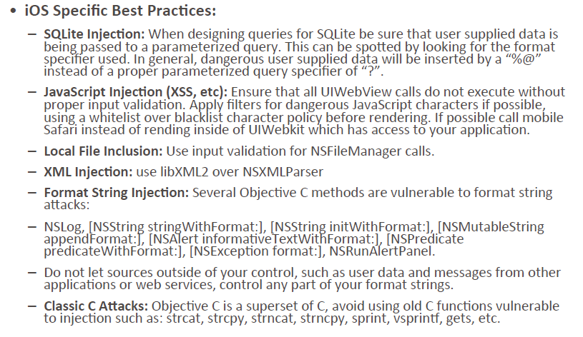
OWASP Mobile Top 10 Risks 2014: Client side injection
v

Slide 38
OWASP Mobile Top 10 Risks 2014: Client side injection
Android Specific Best Practices:
SQL Injection: When dealing with dynamic queries or Content--‐Providers ensure you are using parameterized queries.
JavaScript Injection (XSS): Verify that JavaScript and Plugin support is disabled for any WebViews (usually the default).
Local File Inclusion: Verify that File System Access is disabled for any WebViews (webview.getSepngs().setAllowFileAccess(false);).
Intent Injection/Fuzzing: Verify actions and data are validated via an Intent Filter for all Activities.

Slide 39
OWASP Mobile Top 10 Risks 2014: Security decisions via untrusted Inputs
iOS Specific Examples: –
Do not use the deprecated handleOpenURL method to handle URL Scheme calls. This method does not contain an argument containing the BundleID of the source application.
Instead use the openURL:sourceApplication:annotation method and validation the sourceApplication argument against a white--‐list of trusted applications
Do not use the iOS Pasteboard for IPC communications, as it is susceptible to being set or read by all third party apps on the device.

Slide 40
OWASP Mobile Top 10 Risks 2014: Improper session handling
Failure to Invalidate Sessions on the Backend
Many developers invalidate sessions on the mobile app and not on the server side, leaving a major window of opportunity for attackers who are using HTTP manipulation tools. Ensure that all session invalidation events are executed on the server side and not just on the mobile app.
Lack of Adequate Timeout Protection
Good timeout periods vary widely according to the sensitivity of the app, one's own risk profile, etc., but some good guidelines are:
15 minutes for high security applications
30 minutes for medium security applications
1 hour for low security applications

Slide 41
OWASP Mobile Top 10 Risks 2014: Improper session handling
Failure to Properly Rotate Cookies
Another major problem with session management implementations is the failure to properly reset cookies during authentication state changes. Authentication state changes include events like:
Switching from an anonymous user to a logged in user
Switching from any logged in user to another logged in user
Switching from a regular user to a privileged user
Timeouts
Insecure Token Creation
In addition to properly invalidating tokens (on the server side) during key application events, it's also crucial that the tokens themselves are generated properly. Just as with encryption algorithms, developers should use well--‐established and industry--‐standard methods of created tokens. They should be sufficiently long, complex, and pseudo--‐random so as to be resistant to guessing/anticipation attacks.

Slide 42
OWASP Mobile Top 10 Risks 2014: lack of binary protection
First, the application must follow secure coding techniques for the following security components within the mobile app:
Jailbreak Detection Controls;
Checksum Controls;
Certificate Pinning Controls;
Debugger Detection Controls.
Next, the app must adequately mitigate two different technical risks that the above controls are exposed to: –
The organization building the app must adequately prevent an adversary from analysing and reverse engineering the app using static or dynamic analysis techniques;
The mobile app must be able to detect at runtime that code has been added or changed from what it knows about its integrity at compile time. The app must be able to react appropriately at runtime to a code integrity violation

